Slide 1
Inferential Statistics
“Statistics means never having to say you’re certain” - Anonymous

Slide 2
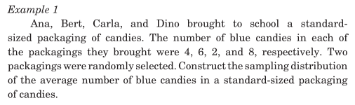
Inferential Statistics

Slide 3
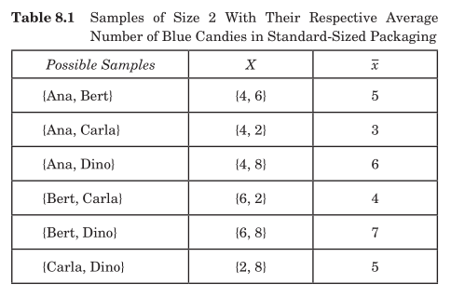
Inferential Statistics

Slide 4
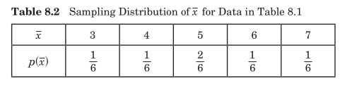
Inferential Statistics

Slide 5
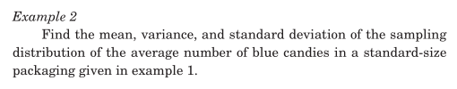
Inferential Statistics

Slide 6
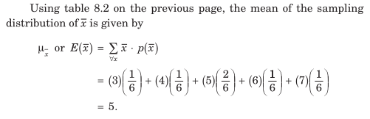
Inferential Statistics

Slide 7
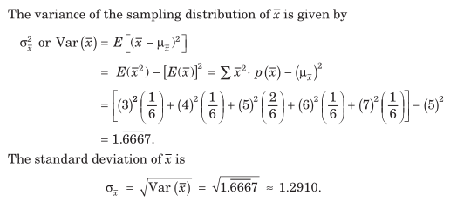
Inferential Statistics

Slide 8
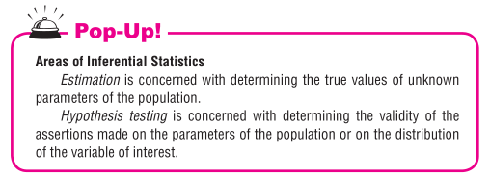
Inferential Statistics

Slide 9
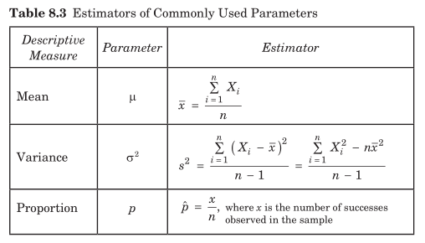
Estimation

Slide 10
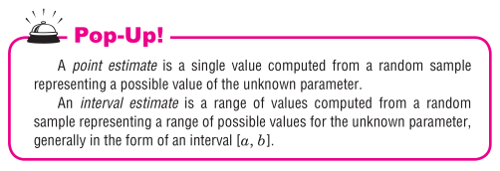
Estimation

Slide 11

Estimation

Slide 12
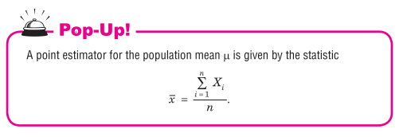
Estimation

Slide 13
Estimating the Population Mean μ
Assumptions:
The population is distributed normally
Population variance is known
Population mean is unknown

Slide 14
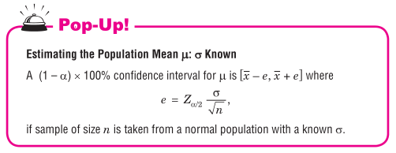
Estimating the Population Mean μ
Assumptions:
The population is distributed normally
Population variance is known
Population mean is unknown

Slide 15
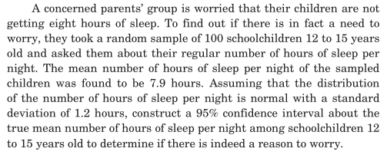
Estimating the Population Mean μ

Slide 16
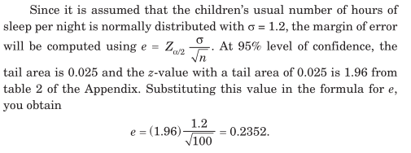
Estimating the Population Mean μ

Slide 17
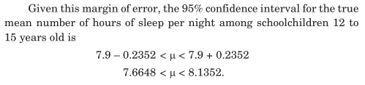
Estimating the Population Mean μ

Slide 18
Estimating the Population Mean μ
Assumptions:
The population may not be normally distributed
Population variance is unknown
Population mean is unknown
Sample size is large (n > 30)

Slide 19
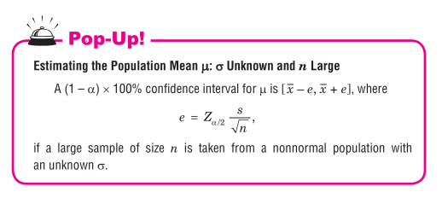
Estimating the Population Mean μ

Slide 20
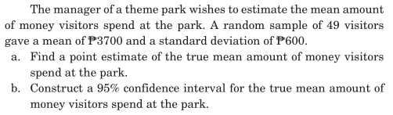
Estimating the Population Mean μ

Slide 21
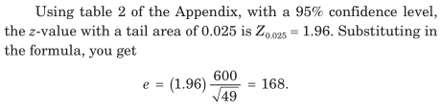
Estimating the Population Mean μ

Slide 22

Estimating the Population Mean μ

Slide 23
Estimating the Population Mean μ
Assumptions:
The population may not be normally distributed
Population variance is unknown
Population mean is unknown
Sample size is small (n < 30)

Slide 24
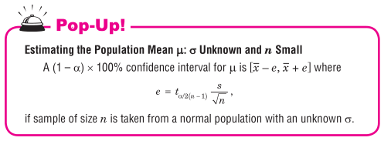
Estimating the Population Mean μ
Assumptions:
The population may not be normally distributed
Population variance is unknown
Population mean is unknown
Sample size is small (n < 30)

Slide 25
Estimating the Population Proportion p

Slide 26

Estimating the Population Proportion p

Slide 27
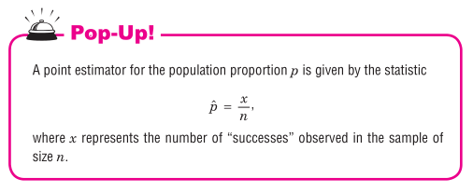
Estimating the Population Proportion p

Slide 28

Estimating the Population Proportion p

Slide 29
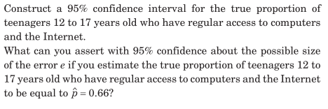
Estimating the Population Proportion p

Slide 30
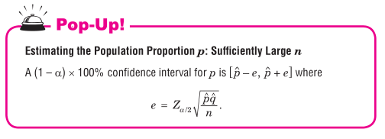
Estimating the Population Proportion p

Slide 31
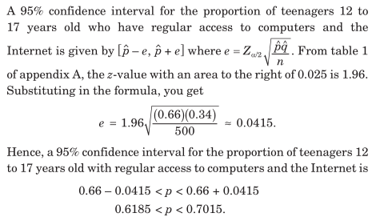
Estimating the Population Proportion p

Slide 32
Sample Size Determination

Slide 33

Sample Size Determination

Slide 34
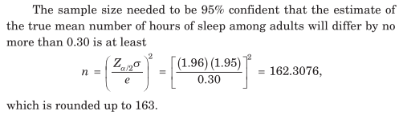
Sample Size Determination

Slide 35
Sample Size Determination

Slide 36
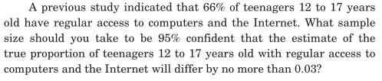
Sample Size Determination

Slide 37
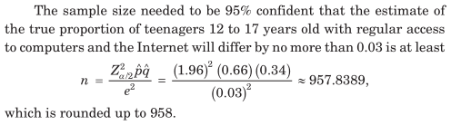
Sample Size Determination

